Slide 1
Disruptive Technology and Practices
The uneasy answer of copyright
Séverine Dusollier
Professor

Slide 2
Disruptive technologies and practices The uneasy answer of copyright
Copyright is an on-going story of adaptations to technological developments
Printing press
Piano rolls, Photography, Broadcasting, satellite
Digital format and Internet: WIPO copyright Treaties in 1996
Relevance and limits of such adaptations
Disruptive practice: open creation
Disruptive technology: AI-based creation

Slide 3
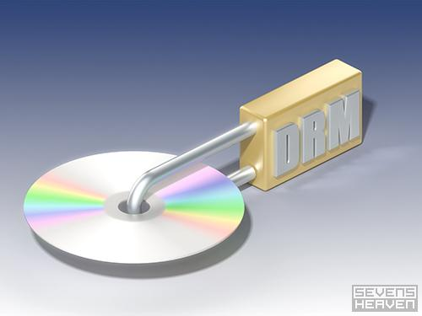
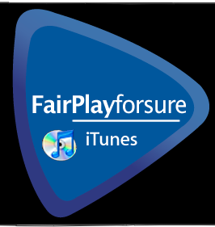
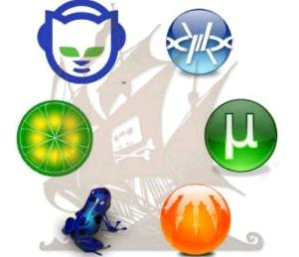
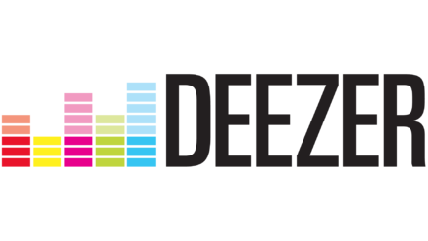
Legal adaptations
EU Directive 2001/29 on copyright in the information society
Mostly new exclusive rights
Adaptations of exceptions
Strengthening enforcement means
Accommodation of new actors: safe harbor for online intermediaries
Enhancing Pan-European Licensing
EU Draft Directive on copyright in the digital single market
Business model adaptations
Digital Rights Management
From P2P to new online services providing content

Slide 4
Are adaptations relevant and sufficient ?
Reasoning on old categories
Any technical copy triggers the reproduction right
Ex: Any exploitation of copyrighted content include many reproductions/ communications
Ex: text and data mining
Fear of online extension of offline uses
Ex: library or online education
Ex: digital exhaustion

Slide 5
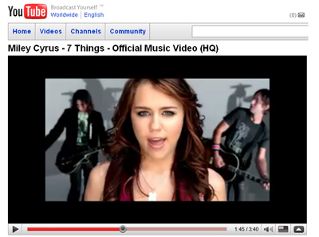
Basics of copyright
Circulation of works to the public
Reasonable Rights covering exploitation
New actors between intermediaries and exploitants
Reasonable Exceptions
Facilitate transactions
No fragmentation of acts of exploitation
EU dimension and cross-border obstacles

Slide 6
Emerging disruptive technologies or practices

Slide 7
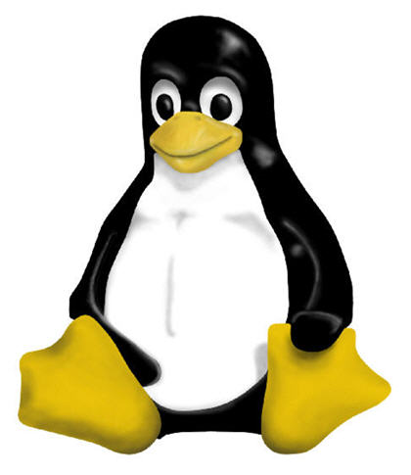
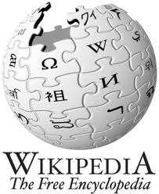
Open source / Open innovation
Key traits
Copyright principles
Collaborative creation
Open and on-going creation
Need to include users
A single author
Clearly bordered and definitive creations
A principle of exclusion
Need for a more inclusive copyright

Slide 8
Artificial Intelligence
18 months of work
Digitization of 346 works of the dutch painter
148 millions of pixels extracted from
168 263 fragments of Rembrandt’s works
ING, Microsoft, J. Walter Thompson Office, Delft University, Mauritshuis et duRembrandt’s House Museum

Slide 9
Artificial Intelligence
Key traits
Copyright Principles
Machine-made creation
Reworkings of many existing creative works
Investment
Human author
Original contribution
Protection of creation
Need for copyright protection ?
Need for a sui generis protection ?

Slide 10
Conclusion
Rethinking the key tenets and justification of copyright protection
Moving away from a technician approach of copyright
… and disruptive technologies or practices will less disrupt copyright
Thanks for your attention
severine.dusollier@sciencespo.fr

